Slide 1


Chew Kar Heng
16/06/2022

Slide 2

Outline
Executive Summary
Introduction
Methodology
Results
Conclusion
Appendix

Slide 3
Executive Summary
Summary of methodologies:
In this capstone project, the methodologies will used are Data Collection, Data Wrangling, Data Analysis, Visual Analytic and Predictive Analysis to explore the data from SpaceX and determine the best prediction method to achieve a higher accuracy of the first stage will land and the cost of a launch.
Summary of all results :
In this capstone project, the result for Data Collection is to show that the data is collected as per given instruction and collected data is in the correct format.
The result in Data Wrangling, should showed the Exploratory Data Analysis (EDA) is performed and from the patterns of the data and he data to determine what would be the label for training supervised models.
The result in Data analysis, should showed that the data is followed as per instruction where the csv is upload to the IBM server and using SQL to query and explore the data.
The result in Visual Analytic, should showed geographical patterns about launch sites.
The result in Data Prediction, will allow the us to know which is the most suitable hyperparameters and model to be used on the SpaceX data.

Slide 4
Introduction
In this Capstone Project, we will predict if the Falcon 9 first stage will land successfully. SpaceX advertises Falcon 9 rocket launches on its website with a cost of 62 million dollars; other providers cost upward of 165 million dollars each, much of the savings is because SpaceX can reuse the first stage. Therefore, if we can determine if the first stage will land, we can determine the cost of a launch. This information can be used if an alternate company wants to bid against SpaceX for a rocket launch.
Problems you want to find answers:
To apply data science toolkit and machine learning in order to accurately predict the likelihood of the first stage rocket landing successfully, and thus determine the cost of a launch.
Explore the data in order to obtain more insight from the data.

Slide 5

Section 1

Slide 6
Methodology
Executive Summary
Data collection methodology:
The data was collected using SpaceX API URL and Web Scraping from the Wikipedia Website.
Perform data wrangling
The data has gone through the process of Data Acquisition, Joining Data and Data Cleaning.
Perform exploratory data analysis (EDA) using visualization and SQL
Perform interactive visual analytics using Folium and Plotly Dash
Perform predictive analysis using classification models
The data in import from the given database. Once the data is retrieved, we need to standardize the data and assign the data into training and test data sets. The dataset will undergo few models to determine the most suitable model

Slide 7
Data Collection
The data sets were collected as below:
The data is collected by using the get request call the data in SpaceX API.
Then decode the response content as a Json using .json() and turn it into a Pandas dataframe using .json_normalize()
We then cleaned the data, that has no information, for example the rocket column has no information about the rocket.
Next, we checked for missing values and fill in missing values and replace with the mean value.
In addition, we performed web scraping from Wikipedia for Falcon 9 launch records with BeautifulSoup.
The objective was to extract the launch records as HTML table, parse the table and convert it to a pandas data frame for future analysis.

Slide 8
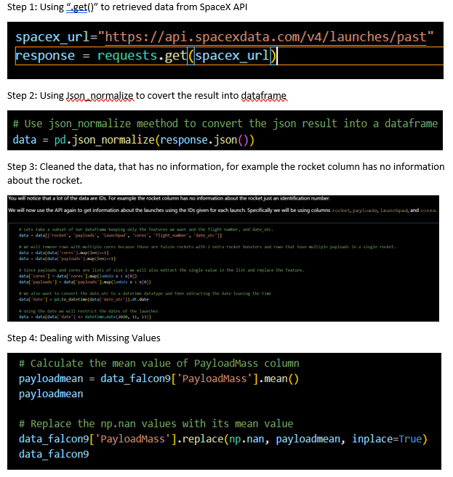
Data Collection – SpaceX API
We used the get request to the SpaceX API to collect data, clean the requested data and did some basic data wrangling and formatting.
The link to the notebook is https://github.com/ACJB/Data-Science-Capstone-Project/blob/907f208add310eba57bbeadc3cedc7ce8ba0f841/jupyter-labs-spacex-data-collection-api.ipynb

Slide 9
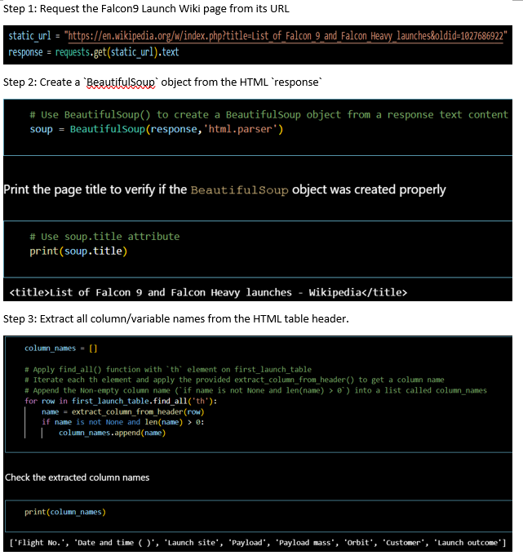
Data Collection - Scraping
We applied BeautifulSoup to webscrap Falcon 9 launch records.
The link to the notebook is https://github.com/ACJB/Data-Science-Capstone-Project/blob/907f208add310eba57bbeadc3cedc7ce8ba0f841/jupyter-labs-webscraping.ipynb
Place your flowchart of web scraping here

Slide 10
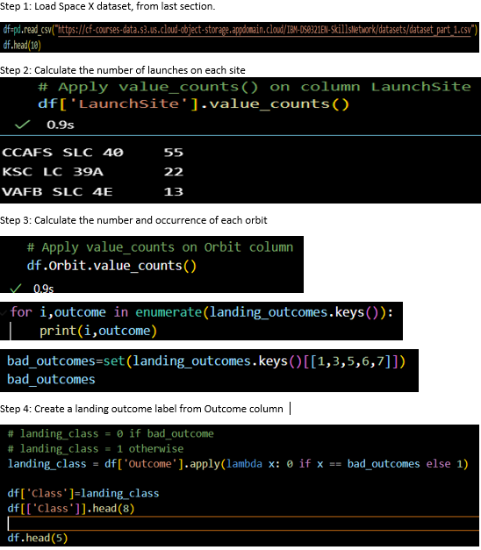
Data Wrangling
In Data Wrangling, we will perform exploratory data analysis and determined the training labels.
We calculated the number of launches at each site, and the number and occurrence of each orbits
We created landing outcome label from outcome column and exported the results to csv.
The link to the notebook is https://github.com/ACJB/Data-Science-Capstone-Project/blob/907f208add310eba57bbeadc3cedc7ce8ba0f841/labs-jupyter-spacex-Data%20wrangling.ipynb

Slide 11
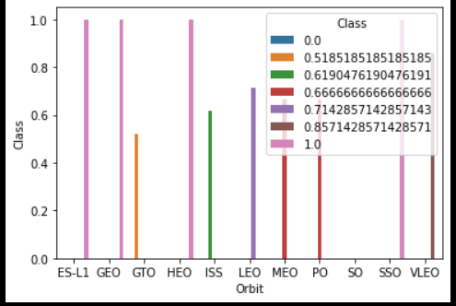
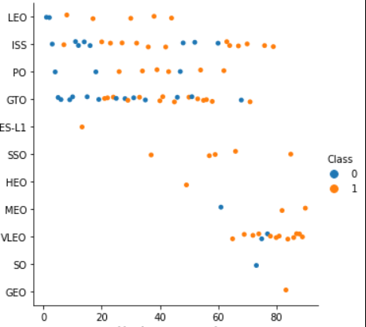
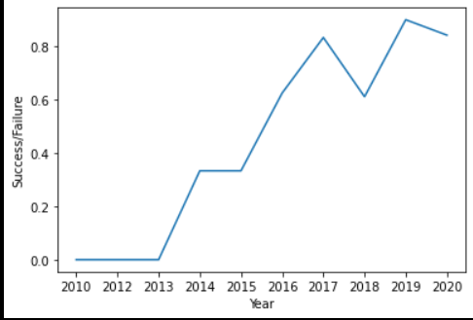
EDA with Data Visualization
In this Capstone project, we have explored Scatter plot, Bar Chart and Line Chart.
Scatter plot feature displaying values for typically two values for a set of data, thus illustrating the degree of correlation between two variables, in this project Scatter plot is used to visualize the relation between payload, flight number and launch site.
Line Chart are used to track changes over short and long periods of time and in the capstone line chart is used to visualize the launch success yearly trend.
Bar Chart are used to compare things between different groups or to track changes over time and in the project bar chart is used to visualize the relationship between success rate of each orbit type
The link to the notebook is https://github.com/ACJB/Data-Science-Capstone-Project/blob/907f208add310eba57bbeadc3cedc7ce8ba0f841/jupyter-labs-eda-dataviz.ipynb

Slide 12
EDA with SQL
We loaded the SpaceX dataset into a PostgreSQL database without leaving the jupyter notebook.
We applied EDA with SQL to get insight from the data. We wrote queries to find out for instance:
The names of unique launch sites in the space mission.
The total payload mass carried by boosters launched by NASA (CRS)
The average payload mass carried by booster version F9 v1.1
The total number of successful and failure mission outcomes
The failed landing outcomes in drone ship, their booster version and launch site names.
The link to the notebook is https://github.com/ACJB/Data-Science-Capstone-Project/blob/1cc2ca5edce077c4da26ca230cba3fac4cca4a47/jupyter-labs-eda-sql-coursera.ipynb

Slide 13
Build an Interactive Map with Folium
The objective is to marked all launch sites, and added map objects such as markers, circles, lines to mark the success or failure of launches for each site on the folium map.
We assigned the feature launch outcomes (failure or success) to class 0 and 1.i.e., 0 for failure, and 1 for success.
Using the color-labeled marker clusters, we identified which launch sites have relatively high success rate.
We calculated the distances between a launch site to its proximities. We answered some question for instance:
Are launch sites near railways, highways and coastlines.
Do launch sites keep certain distance away from cities.
The link to the notebook is https://github.com/ACJB/Data-Science-Capstone-Project/blob/907f208add310eba57bbeadc3cedc7ce8ba0f841/lab_jupyter_launch_site_location.ipynb

Slide 14
Build a Dashboard with Plotly Dash
We built an interactive dashboard with Plotly dash
We plotted pie charts showing the total launches by a certain sites
We plotted scatter graph showing the relationship with Outcome and Payload Mass (Kg) for the different booster version.
The link to the notebook is https://github.com/ACJB/Data-Science-Capstone-Project/blob/907f208add310eba57bbeadc3cedc7ce8ba0f841/Dashboard.py

Slide 15
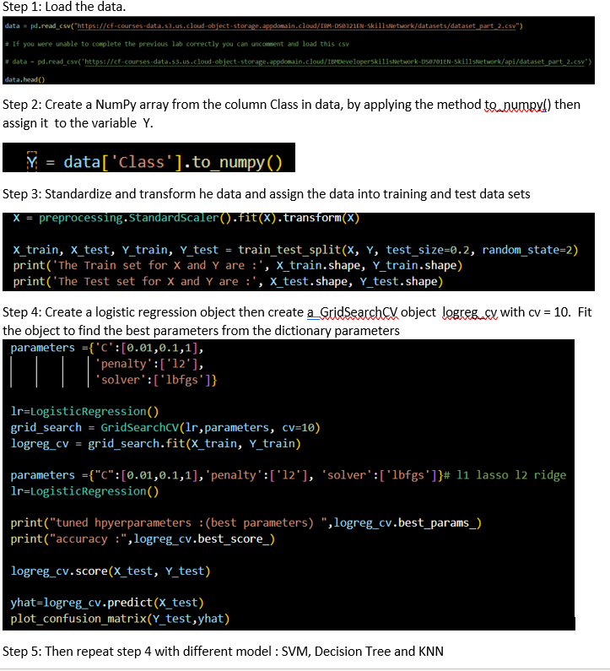
Predictive Analysis (Classification)
Using numpy and pandas to load the data and transformed the data, then split our data into training and testing data set.
We built different machine learning models and use GridSearchCV to test on the different hyperparameters.
Then we check the accuracy for each model and improved the model using feature engineering and algorithm tuning.
We found the best performing classification model.
The link to the notebook is https://github.com/ACJB/Data-Science-Capstone-Project/blob/907f208add310eba57bbeadc3cedc7ce8ba0f841/SpaceX_Machine%20Learning%20Prediction_Part_5.ipynb

Slide 16
Results
Exploratory data analysis results
Interactive analytics demo in screenshots
Predictive analysis results

Slide 17

Section 2

Slide 18
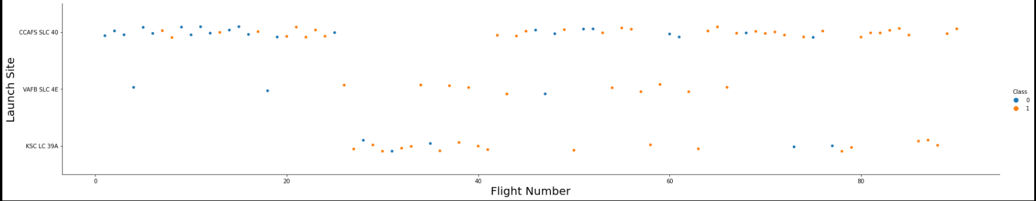
Flight Number vs. Launch Site
Scatter plot of Flight Number vs. Launch Site
From the plot, we can observe that the larger the flight amount at a launch site, the greater the success rate at a launch site.

Slide 19
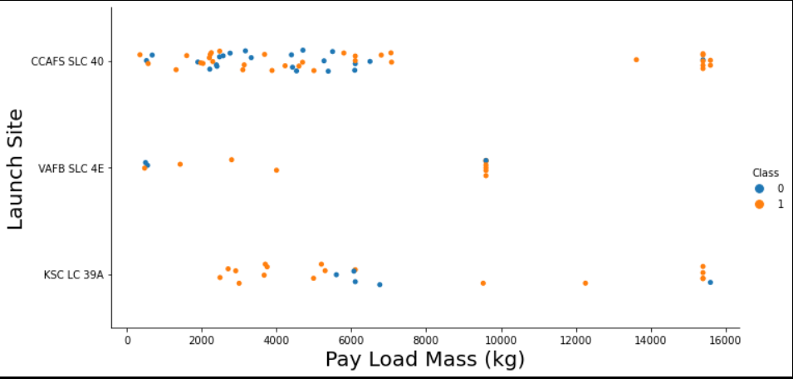
Payload vs. Launch Site
From the plot, we can observe that the greater the payload mass for launch site CCAFS SLC 40, the higher the success rate for the rocket.

Slide 20
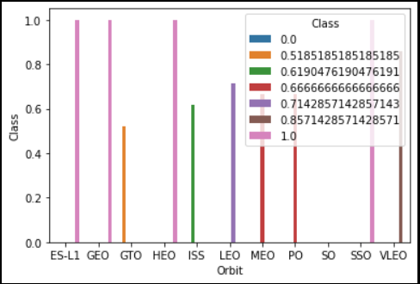
Success Rate vs. Orbit Type
From the plot, we can observe that ES-L1, GEO, HEO, SSO, VLEO had the most success rate.

Slide 21
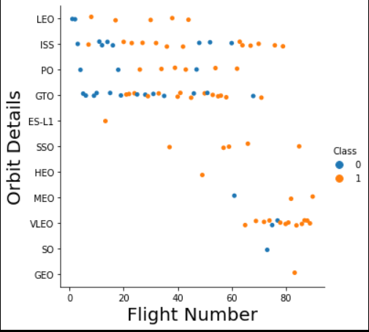
Flight Number vs. Orbit Type
From the plot we can observe that in the LEO orbit, success is related to the number of flights whereas in the GTO orbit, there is no relationship between flight number and the orbit.

Slide 22
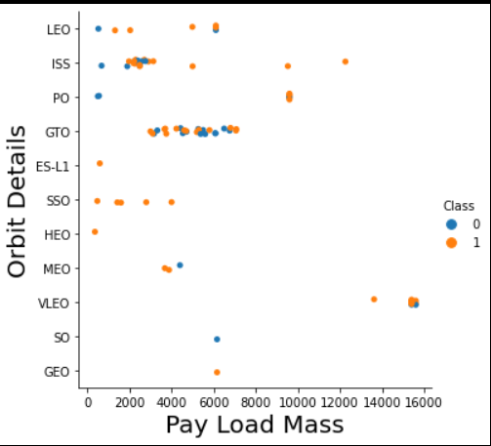
Payload vs. Orbit Type
From the plot we can observe that with heavy payloads, the successful landing are more for PO, LEO and ISS orbits.

Slide 23
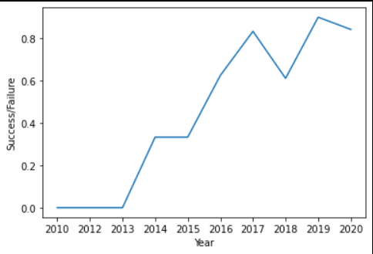
Launch Success Yearly Trend
From the plot, we can observe that success rate since 2013 kept on increasing till 2017.
The success rate has slightly drop in between 2017 to 2018 and increase in 2019.

Slide 24
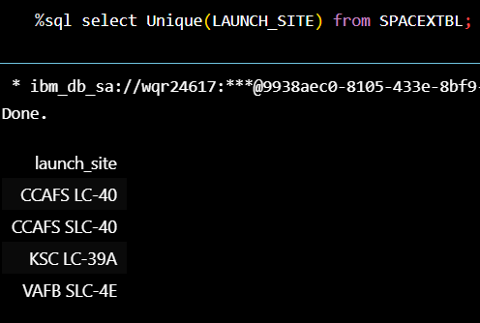
All Launch Site Names
By using the key word Unique() the program will show the unique launch site name without overlapping sites from the SpaceX data.

Slide 25
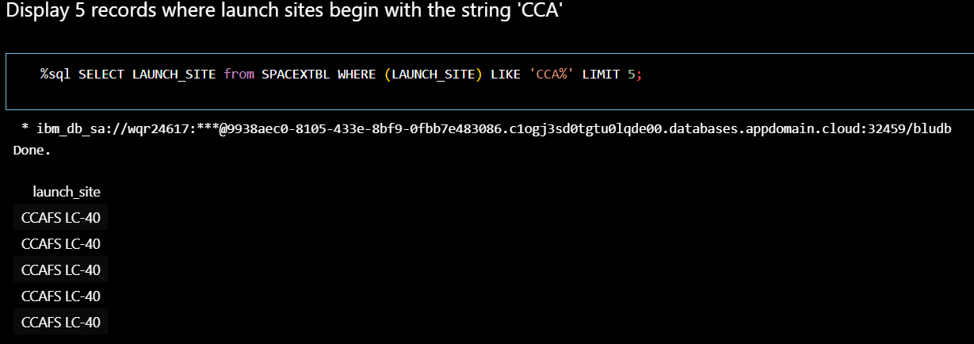
Launch Site Names Begin with 'CCA'
We used the query above to display 5 records where launch sites begin with `CCA`

Slide 26
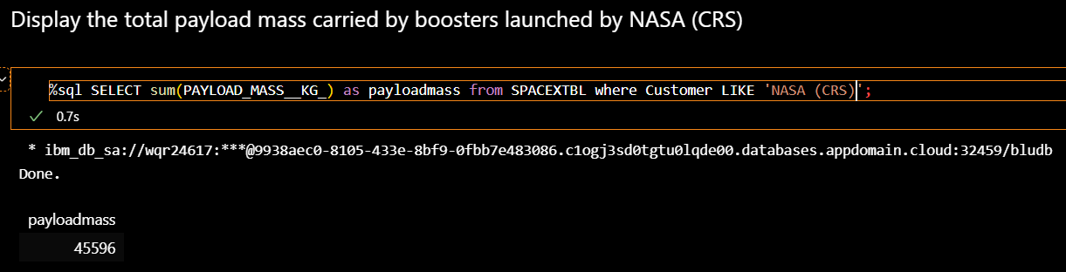
Total Payload Mass
From the code above, we calculated the total payload mass carried by boosters from NASA (CRS) is 45596.

Slide 27
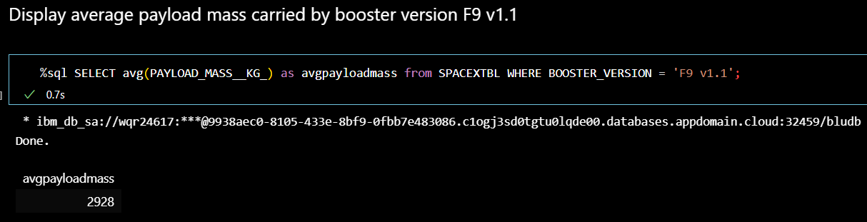
Average Payload Mass by F9 v1.1
From the code above, we calculated average payload mass carried by booster version F9 v1.1 is 2928.

Slide 28
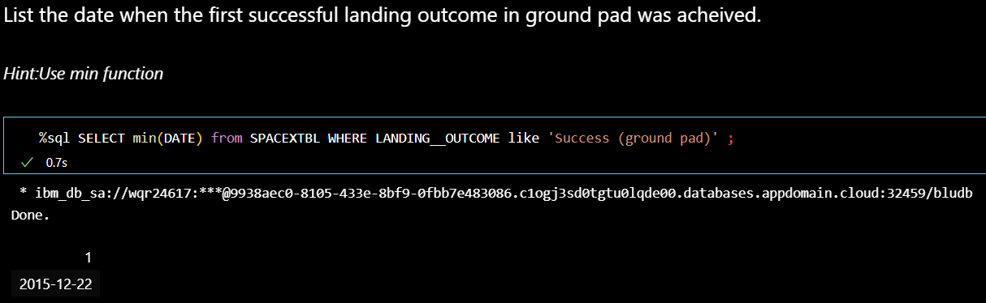
First Successful Ground Landing Date
The dates of the first successful landing outcome on ground pad was 22/12/2015

Slide 29
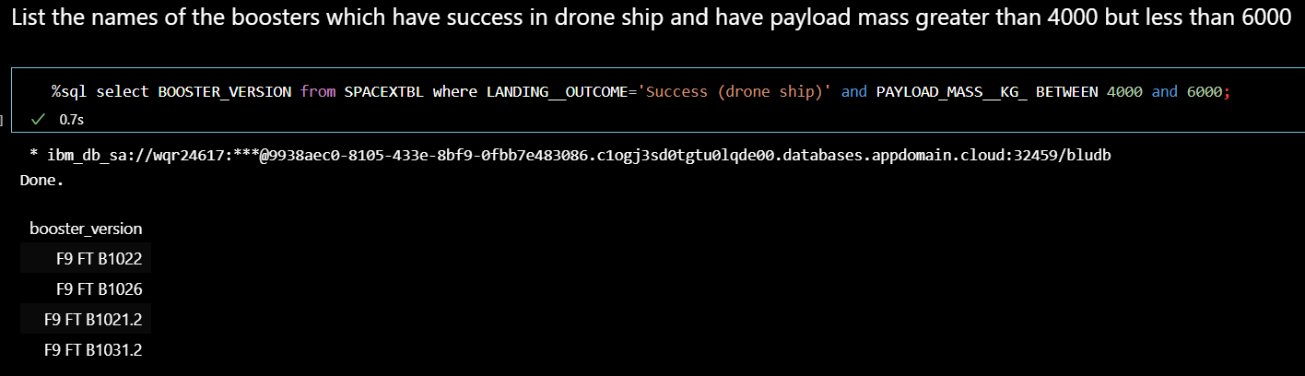
Successful Drone Ship Landing with Payload between 4000 and 6000
We used the WHERE clause to filter the landing outcome which have successfully landed on drone ship and applied the AND condition to determine successful landing with payload mass greater than 4000 but less than 6000.

Slide 30
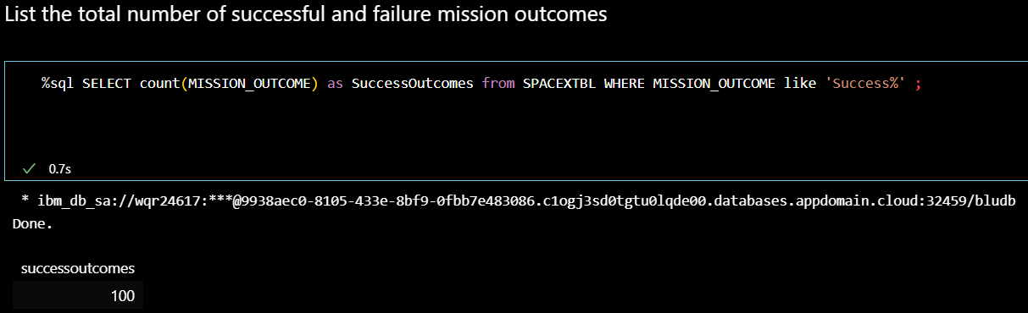
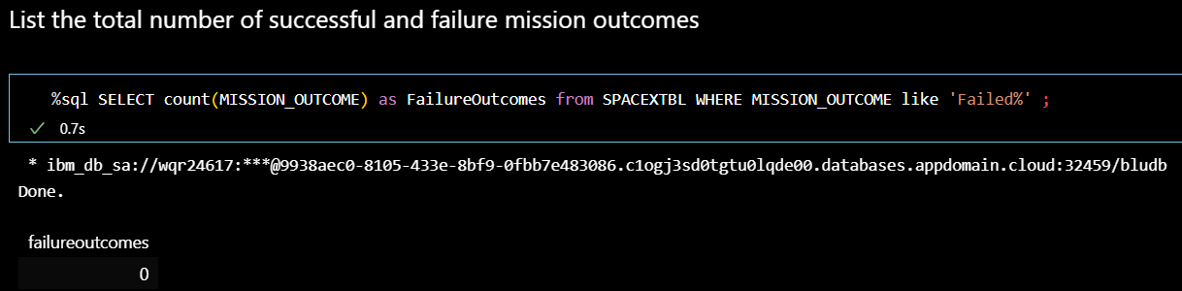
Total Number of Successful and Failure Mission Outcomes
From the code above we can see that the Success outcome rate is 100, therefore the Failure outcome rate is 0.

Slide 31
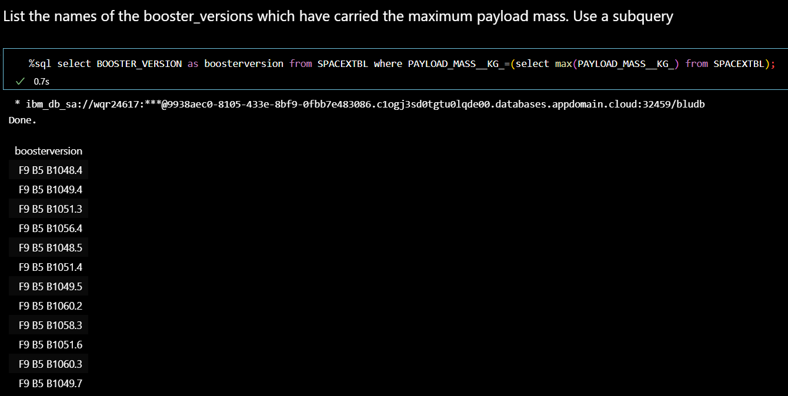
Boosters Carried Maximum Payload
We determined the booster that have carried the maximum payload using a subquery in the WHERE clause and the MAX() function.

Slide 32
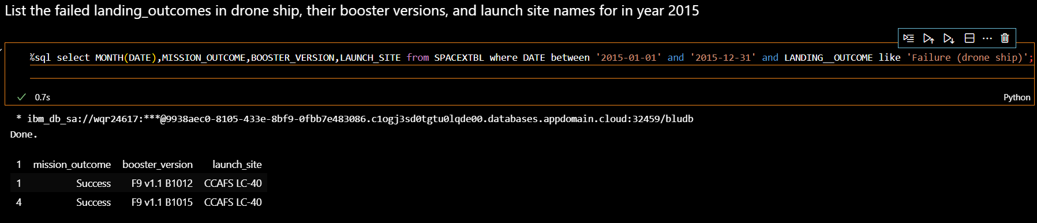
2015 Launch Records
By using the WHERE clause, LIKE, AND, and BETWEEN conditions to filter for failed landing outcomes in drone ship, their booster versions, and launch site names for year 2015

Slide 33
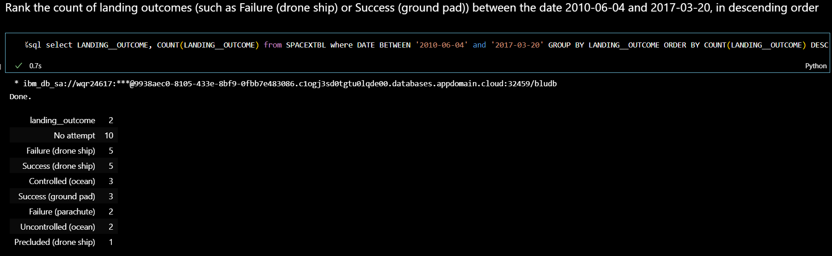
Rank Landing Outcomes Between 2010-06-04 and 2017-03-20
We selected Landing outcomes and the COUNT of landing outcomes from the data and used the WHERE clause to filter for landing outcomes BETWEEN 2010-06-04 to 2017-03-20.
We applied the GROUP BY clause to group the landing outcomes and the ORDER BY clause to order the grouped landing outcome in descending order.

Slide 34

Section 3

Slide 35
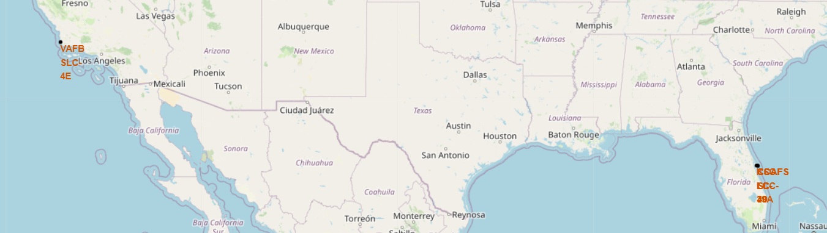
All launch sites global map markers
Based on the Observation we can see that the launches site is located at Florida and California

Slide 36

Markers showing launch sites with color labels
Replace <Folium map screenshot 2> title with an appropriate title
Explore the folium map and make a proper screenshot to show the color-labeled launch outcomes on the map
Explain the important elements and findings on the screenshot

Slide 37

Launch Site distance to landmarks
Replace <Folium map screenshot 3> title with an appropriate title
Explore the generated folium map and show the screenshot of a selected launch site to its proximities such as railway, highway, coastline, with distance calculated and displayed
Explain the important elements and findings on the screenshot

Slide 38

Section 4

Slide 39
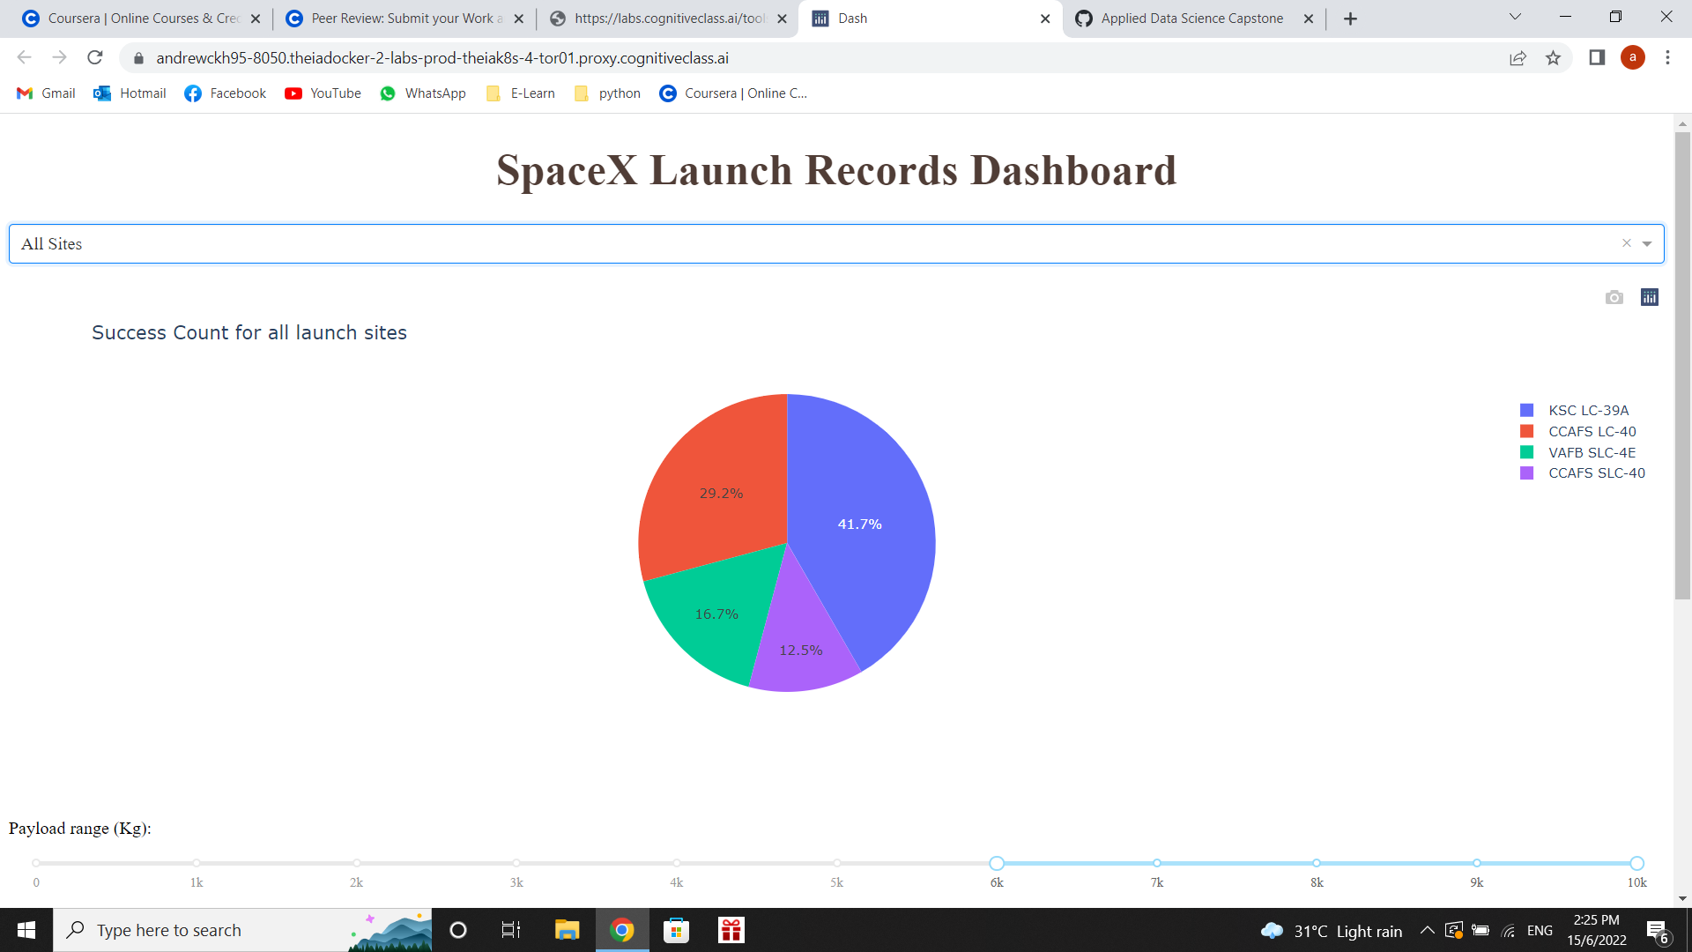
Pie chart showing the success percentage achieved by each launch site
Based on the Pie Chart we can observe that KSC LC-39A holds the highest success launch rate from all sites.

Slide 40
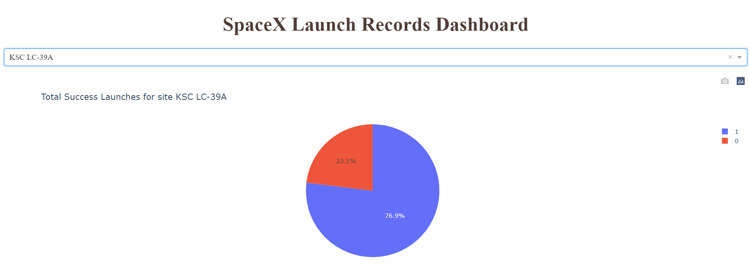
Pie chart showing the Launch site with the highest launch success ratio
Based on the Pie Chart we can observe that KSC LC-39A achieved a success rate of 76.9% with a 23.1% failure rate.

Slide 41
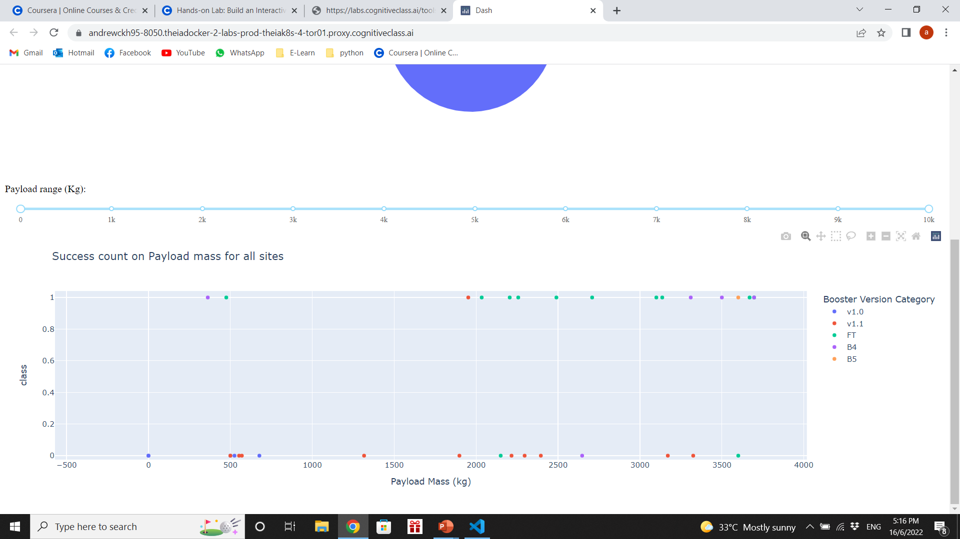

Scatter plot of Payload vs Launch Outcome for all sites, with different payload selected in the range slider
Based on the observation we can observe that the success rate is higher in the range 0 kg to 4000 kg than the range 4000 kg to 10000 kg

Slide 42

Section 5

Slide 43
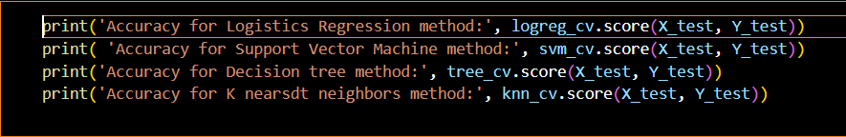
Classification Accuracy
By showing the score of all model, we can see that the model that having the Highest accuracy of 87% is the Decision Tree Model.

Slide 44
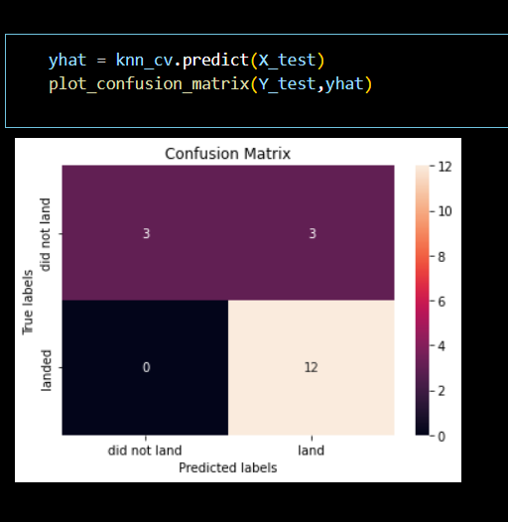
Confusion Matrix
The confusion matrix for the decision tree classifier shows that the classifier can distinguish between the different classes. The major problem is the false positives .i.e., unsuccessful landing marked as successful landing by the classifier.

Slide 45
Conclusions
The larger the flight amount at a launch site, the greater the success rate at a launch site.
Launch success rate started to increase in 2013 till 2017 and drop on 2018 then increasing till 2020.
Orbits ES-L1, GEO, HEO, SSO, VLEO had the most success rate.
KSC LC-39A had the most successful launches of any sites.
The Decision tree classifier is the best machine learning algorithm for this task.

Slide 46
Appendix
The outcome of the Dashboard can be found as per link: https://github.com/ACJB/Data-Science-Capstone-Project/blob/1cc2ca5edce077c4da26ca230cba3fac4cca4a47/Dashboard.py

Slide 47


